Slide 1

Image Caption generator
Saikumar Cherku - 700742475
Appalaswamy Yalamanchily - 700747726
Divya Pothuru - 700746292
Sai Vinay Reddy Panala - 700740027

Slide 2
Roles AND RESPONSIBILITIES
Project flow design – Saikumar
Image Data Processing – Divya
VGG16 model implementation – Saikumar, Appalaswamy
Image data feature extraction – Appalaswamy
Captions data analysis – Divya
Captions data feature extraction – Divya
LSTM model Implementation – Vinay
Predicting the captions for images – Vinay
Code review – Appalasawamy
Final Report – Saikumar
Documenting final result – Divya, Vinay

Slide 3
Motivation
Accessibility :
Make visual information accessible to individuals who are visually impaired or blind.
Automation :
Automatically generate captions for large volumes of images, which can be used for a variety of purposes such as marketing, advertising, and social media
Personalization :
More interesting and customized experience for users by fabricating captions based on individual preferences, user-generated content, and other criteria.

Slide 4
OBJECTIVES
It aims to implement an Image caption generator that responds to the user to get the captions for a provided image.
To generate the accurate and informative captions.
To improve the accessibility for visual impaired individuals.
To enhance user experience
To improve machine learning models and enable automation of image analysis.
To enhance the search engine optimization.

Slide 5
Problem Statement
Visually impaired individuals make up a significant proportion of the global population, with people requiring assistance for reading or checking information. Accessing information from images is particularly challenging for these individuals. Therefore, there is a need to develop a system that can extract and process information from images and present it in an accessible format for visually impaired individuals.
Deep learning, a subset of machine learning, has shown promise in processing information from images, and image captioning projects that mimic human understanding of images could be a potential solution.
However, further research is needed to develop a robust and accurate system that can effectively serve the needs of visually impaired individuals.

Slide 6
Related works
Deep context-encoding network for retinal image captioning.
Thai transformer based image captioning.
They are unable to produce adequate captions on images with noise.
Show and Tell : A Neural Image Caption Generator
Works fine only with images with the dataset
Remote sensing image change captioning with dual-branch transformers.
Explainability for medical image captioning.
- The former is that it cannot provide new descriptions. The latter could be impacted by incorrect scene or semantic object identification

Slide 7
PROPOSED SOLUTION
In this project we propose a combination CNN, a simple processing technique and RNN neural network and LSTM for text classification to generate the meaningful captions. In the end the performance of the test dataset is evaluated using accuracy and BLEU(BiLingual Evaluation Understudy) score to check the accuracy of the predictions.
Detecting Objects
Data Sets Used
Flickr8k
8000 images, each with annotated with 5 sentences via AMT
1000 for validation, testing
VGG-16 to extract Image features
LSTM for Caption Generation
CNN
Converting to Natural Language
RNN & LSTM
Generating Caption
Using vigorous training and pre-trained libraries
Notes:
We will be removing the last layer of VGG-16 model as this is used for object classification.
Merging the images and captions for training
As the model can not take texts as an input, they need to converted to vectors
Processing the captions and images as per the model standard type input type.
LSTM ( Long Short-Term Memory ) model and tried generating caption on test data set.
Find the BLUE (Bilingual Evaluation Understudy Score ) score.

Slide 8
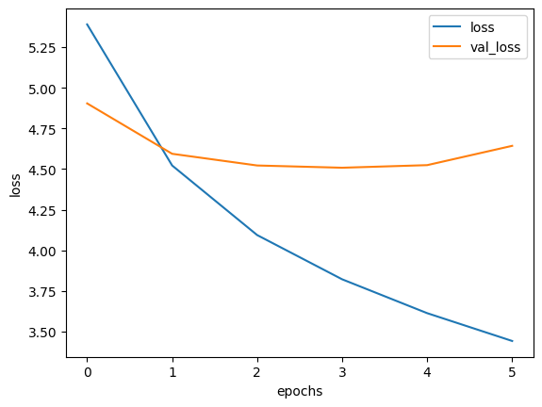
RESULTS
By fine-tuning the model with various hyperparameters, the caption generation has continuously improved. With a higher BLEU score, the produced captions are more likely to match the real captions on the photos.
The validation loss decreases up until the fifth epoch and then increases, while the training loss keeps decreasing.
Even while the training loss diminishes over time, the validation loss typically increases after the fifth epoch. This suggests that the model is too well-fitted and that training should be stopped.
If the model overfits on your training data, it will cause the model to examine image details and produce captions that are illogical.

Slide 9
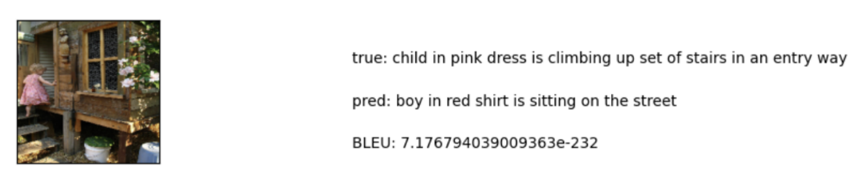
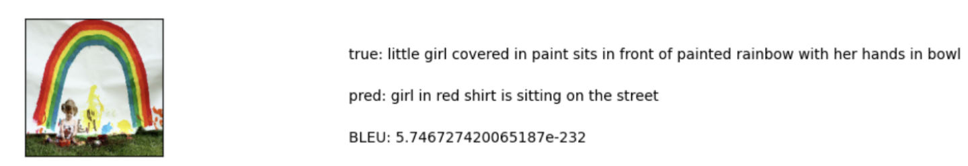
Results

Slide 10
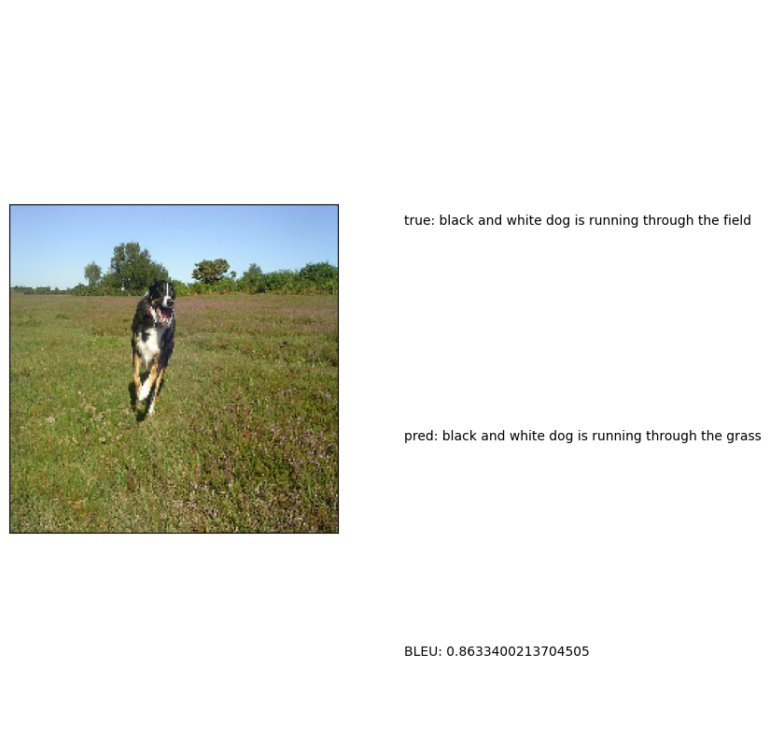
RESULT

Slide 11
References
[1] Jia-Hong Huang, Ting-Wei Wu, Chao-Han Huck Yang, and Marcel Worring. Deep context-encoding network for retinal image captioning. In 2021 IEEE International Conference on Image Processing (ICIP).
[2] Teetouch Jaknamon and Sanparith Marukatat. Thaitc:thai transformerbased image captioning. In 2022 17th International Joint Symposium on Artificial Intelligence and Natural Language Processing (iSAI-NLP).
[3] Apoorva Krisna, Anil Singh Parihar, Aritra Das, and Arnav Aryan. Endto-end model for heavy rain image captioning. In 2022 4th International Conference on Advances in Computing, Communication Control and Networking (ICAC3N).
[4] Xinru Wei, Yonggang Qi, Jun Liu, and Fang Liu. Image retrieval by dense caption reasoning. In 2017 IEEE Visual Communications and Image Processing (VCIP).
[5] Ruchika Malhotra, Tanmay Raj, and Vedika Gupta. Image captioning and identification of dangerous situations using transfer learning. In 2022 6th International Conference on Computing Methodologies and Communication (ICCMC).
[6] Prashant Giridhar Shambharkar, Priyanka Kumari, Pratik Yadav, and Rajat Kumar. Generating caption for image using beam search and analyzation with unsupervised image captioning algorithm. In 2021 5th International Conference on Intelligent Computing and Control Systems (ICICCS).

